Slide 1
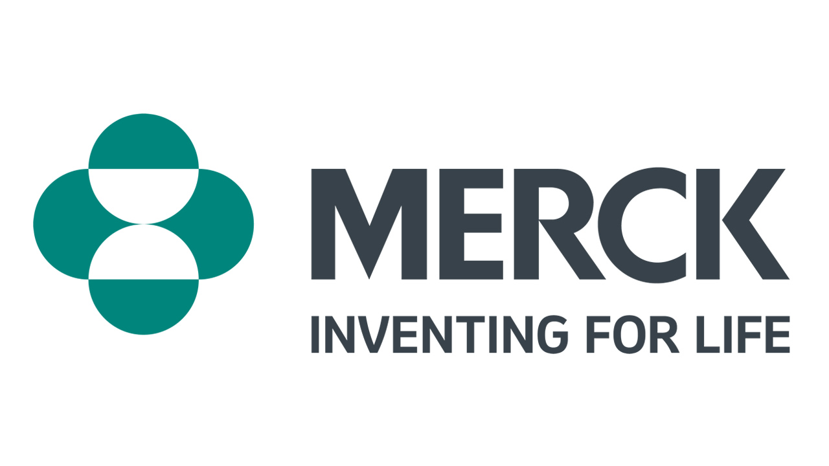
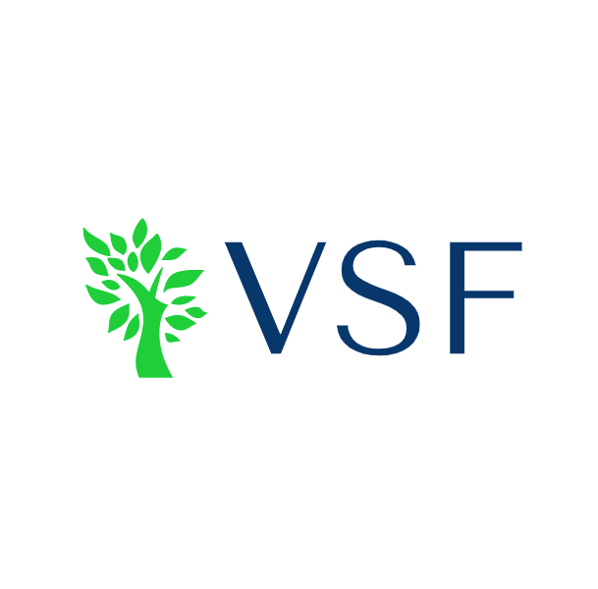
Current Price: $106.14 (2/17/22)
Price as of Analysis: $98.75 (11/03/22)
Target Price: $130 to $200
Time Horizon: 12-18 Months
Director: Anthony Eduafo and Ryan Harris
Analysts: Patrick Kerrigan, Julia Lawless, Bryan Lee, Marc Milano, Cailan Baker

Slide 2
I. Executive Summary
Industry Overview
Financial Overview
IV. Environmental, Social & Governance Analysis
V. Competitive Landscape
VI. Catalysts and risks
VII. Investment Rationale
VIII. Comps and DCF Models (Financial Models)

Slide 3
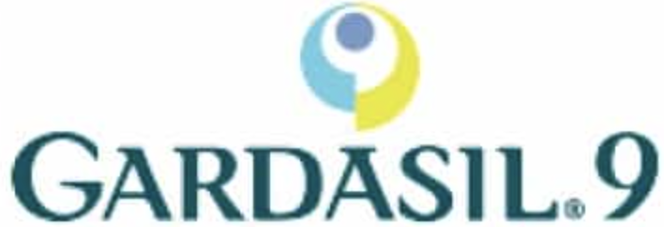
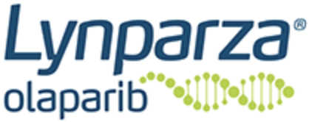
Merck Overview
Executive Summary
Overview
Company Highlights
Headquarters: Rahway, NJ
Founded: 1891
Employees: 68,000
Description: American multinational pharmaceutical company that delivers innovative health solutions through its prescription medicines, vaccines, animal health products, and biological therapies segments.
130+ years bringing hope to humanity through the development of medicines and vaccines
$12.2 billion
spent in 2022 on finding new cures and solutions
68,000 employees working around the world to make a lasting impact on health
Product Areas
Advancing Innovation
Merck is constantly advancing innovation
Pharmaceutical
Vaccines
Animal Health
Bio Therapies
Trusted Brands
Pioneering New Vaccines
Data Science Partnerships
Accelerating Global Access
Market Leadership
Merck is a leader in the following areas
Oncology
Cardiovascular
Respiratory
Veterinary Medicine
Vaccine Development
HPV
Sources: Drugwatch, Fortune, Company Website
Notes:
Anthony or Bayron

Slide 4
I. Executive Summary
Industry Overview
Financial Overview
IV. Environmental, Social & Governance Analysis
V. Competitive Landscape
VI. Catalysts and risks
VII. Investment Rationale
VIII. Comps and DCF Models (Financial Models)

Slide 5
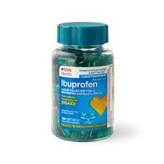
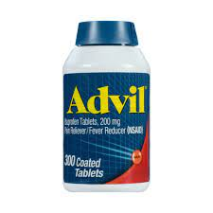
Market Trends
Industry Overview
Today's pharma clientele require new pharmaceutical solutions that will render drug development, discovery, and usage easier
Trends in Pharmaceutical Market
Increasing Demand for Pharmaceuticals
Key Indicators for a growing market in Pharmaceuticals
Y/Y Growth in Worldwide Prescription Drug Sales ($ in billions)
Increasing Geriatric Population
13.4% increase in over the past 5 years resulting in larger demand for prescription drugs
12.5% increase in retail drug expenditures since 2016
W
$ in billions
Increasing Profit Margins
Margins have increased to almost 20% for big pharma over the past five years.
Companies earning 25 cents to the dollar, beating industry average of 12 cents
Years
Non-Cyclical Industry
Despite market-wide downturn of 24.8%, pharmaceuticals have experienced a 9% gain
Demand for prescription drugs is relatively inelastic and industry wide beta averages 1.08
Generic Drug
Brand-Name Drug
Sources: WSJ, NCBI, Statista, Firsthand, PremierConsulting, NYU
Notes:
Bayron

Slide 6
I. Executive Summary
Industry Overview
Financial Overview
IV. Environmental, Social & Governance Analysis
V. Competitive Landscape
VI. Catalysts and risks
VII. Investment Rationale
VIII. Comps and DCF Models (Financial Models)

Slide 7
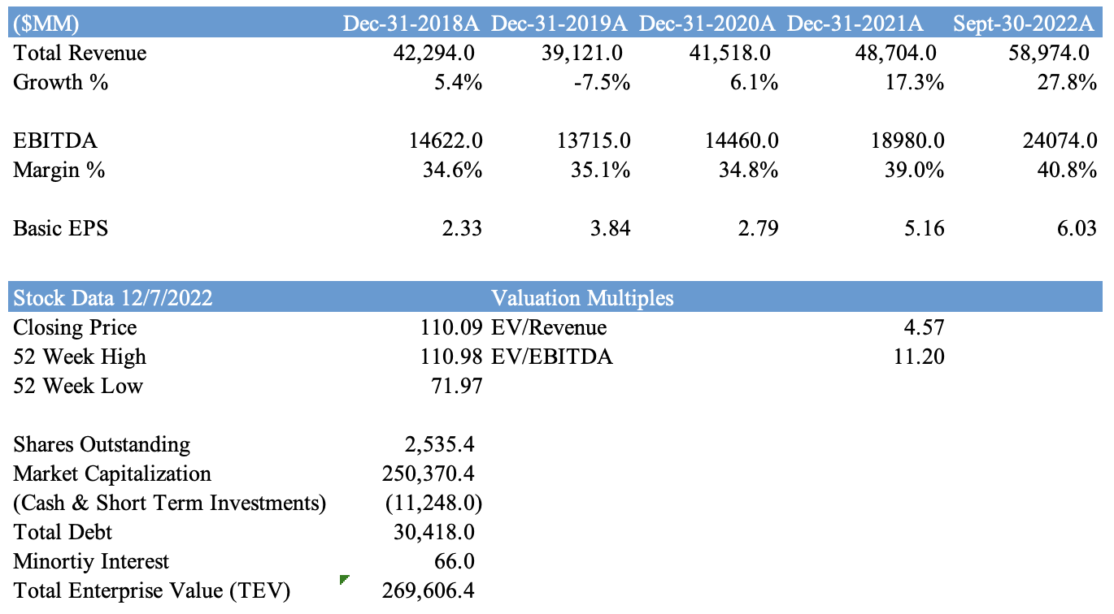
Historical data and financial highlights
Financial Overview
Revenue Highlights
277.2% EPS Growth over 5-Year Period
Increase in Total Revenue of 45.52% over last 5-Year Period​
Q3 2022 worldwide sales of $15 billion, an increase of 14% from Q3 2021
45.8% EBITDA growth from Q3 2021
Sales of Keytruda grew 20% to $5.4B in Q3 2022
Outperformed analyst-projected EPS by 8% in Q3 2022
Sources : Capital IQ, Merck Q3 2022 Earnings Report, WSJ
Notes:
Ahmed

Slide 8
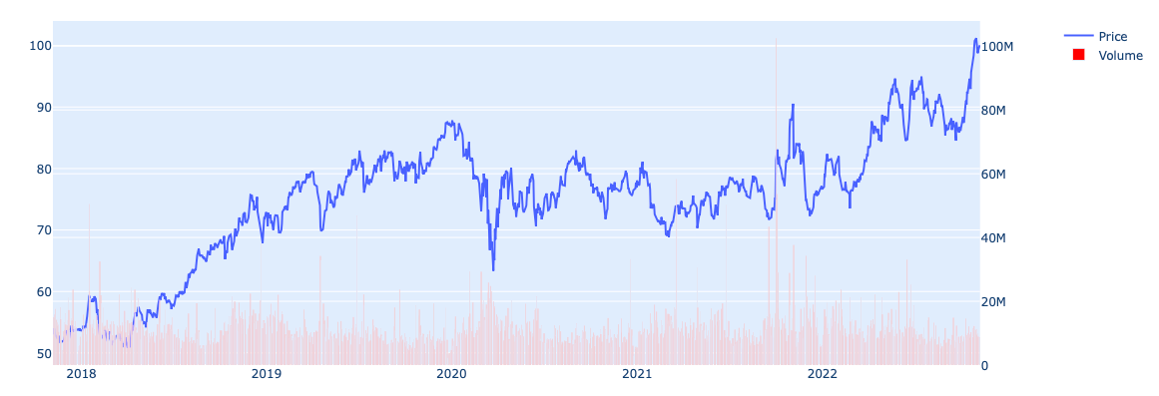
Stock Chart & Enterprise Value
Financial Overview
5 Year Stock Data
Enterprise Value Calculation ($MM)
Sources: Capital IQ
Notes:
Ahmed

Slide 9
I. Executive Summary
Industry Overview
Financial Overview
IV. Environmental, Social & Governance Analysis
V. Competitive Landscape
VI. Catalysts and risks
VII. Investment Rationale
VIII. Comps and DCF Models (Financial Models)

Slide 10
Environmental, social & governance analysis
Analyst Commentary
ESG Analysis
Environmental
Social
Governance
Carbon Neutrality
Recently announced that Merck will be completely carbon neutral by 2025.
Energy
Merck signed three new virtual power purchase agreements (VPPAs) for utility-scale energy projects based in Texas and Spain. Projects will address 35% of Merck’s Scope 2 emissions and 30% of scope 1 emissions by collectively adding 145 MW of solar and wind energy to the grid.
Pay
Greater than 99% pay equity achieved in the U.S. for male and female employees, as well as white and non-white employees in equivalent positions
Leadership
Number of women in senior management positions have increased from 31% to 40% from last year to this year
Supply Chain
Supply chain is open and visible for the public to view. No infractions thus far via the supply chain.
Transparency
“Speak Up” culture in addition to transparency within Supply Chain and accidents within and around the workplace
Notable Mentions
Merck have an ESG Risk Rating of 19.8 (Low Risk) on a scale from 1-40+
Ranked 60th out of 898 out of all Pharma (1st being least ESG risk)
Sources: Sustainanalytics.com and Merck ESG Report
Notes:
Bayron

Slide 11
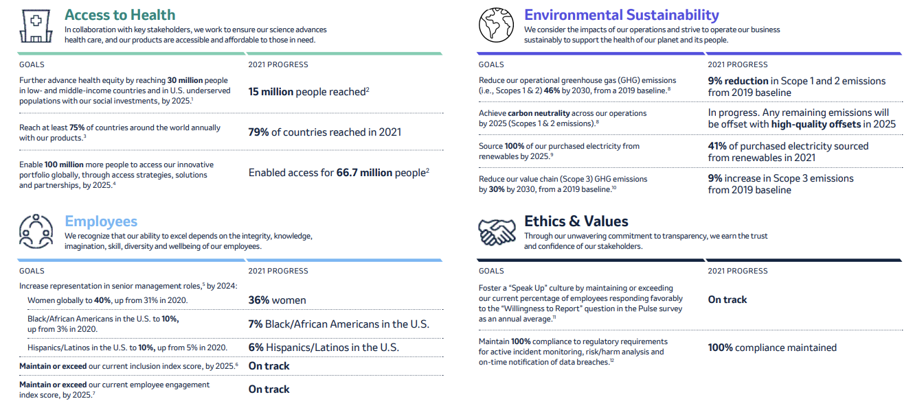
Merck ESG Goals and Progress Continued
Source: Merck ESG Report

Slide 12
I. Executive Summary
Industry Overview
Financial Overview
IV. Environmental, Social & Governance Analysis
V. Competitive Landscape
VI. Catalysts and risks
VII. Investment Rationale
VIII. Comps and DCF Models (Financial Models)

Slide 13
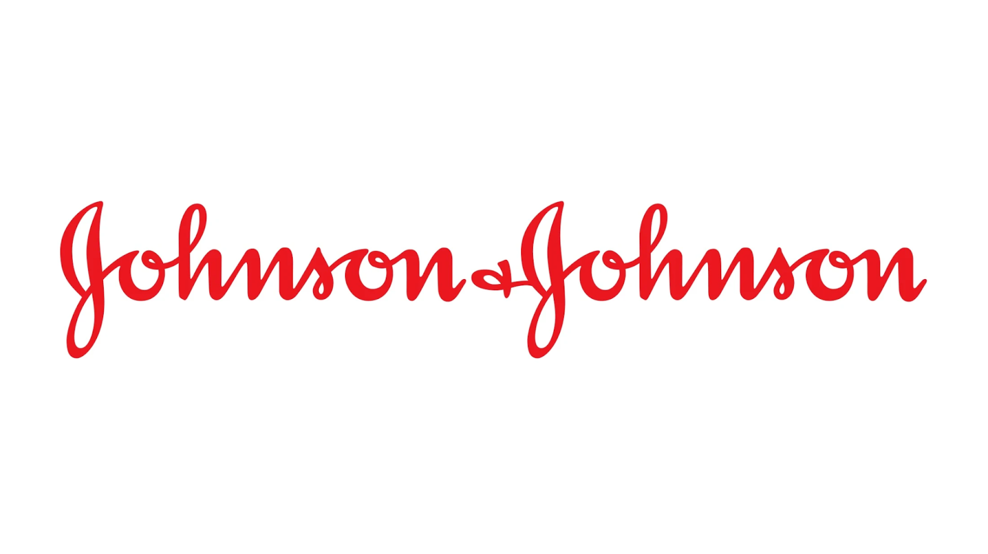
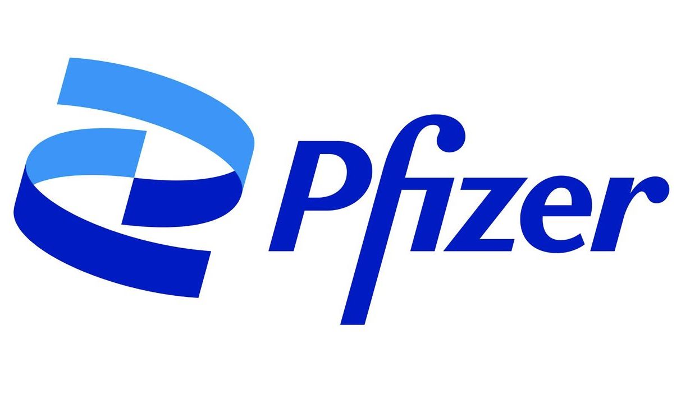
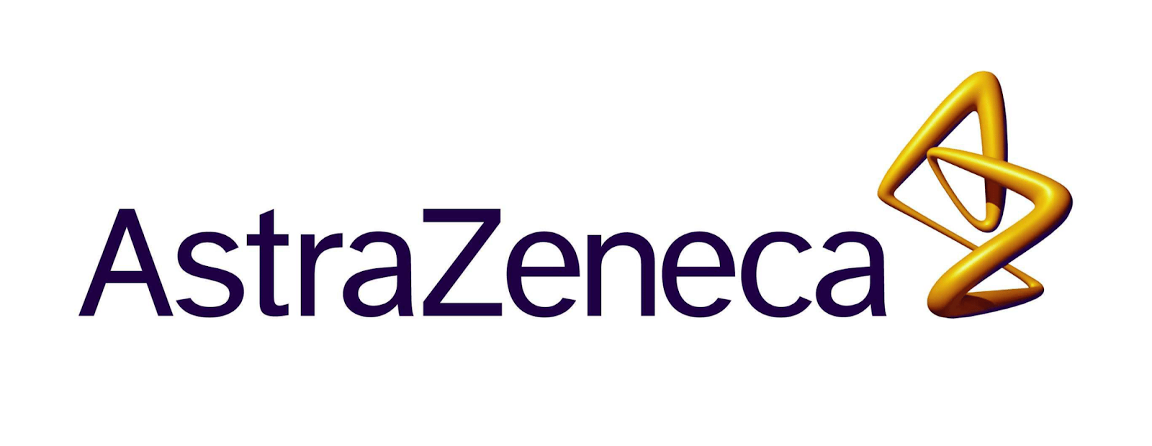
Competitive Landscape
Founded: 1886
Market Cap: 415.781 B
Share Price: 159.02
P/E: 23.63
Beta: 0.54
Founded: 1849
Market Cap: 241.821 B
Share Price: 43.08
P/E: 7.88
Beta: 0.58
Founded: 1999
Market Cap: 220.781 B
Share Price: 68.74
P/E: 65.47
Beta: 0.19
Overview
Pharmaceuticals: Delivers novel medicines for immunological diseases. Continues to build a pipeline of innovative biologic and oral therapies in core disease areas: rheumatoid arthritis, inflammatory bowel diseases, and psoriasis
Medical Devices: Offers a large variety of products such as hip, knee and shoulder replacements, and operating room products
Consumer: Produces a broad range of products focused on personal healthcare used in the skin health and beauty, over-the-counter medicines, baby care, oral care, women's health, and wound care markets
Overview
Vaccines: Has a long history in vaccine research and development, including a pivotal role in the eradication of polio and smallpox. They’ve innovated solutions for preventing deadly bacterial infections like those caused by S. pneumoniae and N. meningitidis
Medicine: Develop and produce medicines for immunology, oncology, cardiology, endocrinology, and neurology
Consumer: Products include over-the-counter medicines, supplements and other products that are top sellers in their categories and household names for consumers around the world
Overview
Pharmaceuticals: Develops a wide range of drugs. They have a diversified drug portfolio for major diseases in areas including oncology, cardiovascular, gastrointestinal, infection, neuroscience, respiratory, and inflammation
Achieve their ambition of transforming healthcare through their talented teams and partners using scientific, medical and commercial innovation
Focused on creating innovative medicines and improving access to them. They deliver great benefit to patients, healthcare systems and societies globally
Sources: FactSet & Company Pages
Notes:
Bayron

Slide 14
I. Executive Summary
Industry Overview
Financial Overview
IV. Environmental, Social & Governance Analysis
V. Competitive Landscape
VI. Catalysts and risks
VII. Investment Rationale
VIII. Comps and DCF Models (Financial Models)

Slide 15
Catalysts & Risks
Catalysts
Risks
Robust Oncology Portfolio
Recent U.S. FDA approval of Keytruda for patients with advanced endometrial carcinoma
Reductions in HPV-Related diseases with use of Gardasil according to new literature review
Lack of Pricing Increases
Current pharmaceutical legislation is aimed at curbing drug prices
Merck's average annual net price increase underperforms yearly inflation rate
Promising Cardiovascular Portfolio
Recent U.S. FDA fast track designation for MK-2060, an anticoagulant therapy for thrombosis
Positive results from phase 3 STELLAR trial evaluating
Sotatercept
Occasional Legal Hurdles
Lawsuits filed by patients who experience adverse reactions to medication
Suing the government to avoid fines for cutting off 340B contract pharmacies from getting discounted products.
Lucrative Partnerships
New collaboration with Moderna to create a cancer vaccine for melanoma patients
Strategic agreement with Veeva for digital strategy acceleration and efficiency using cloud-based products
Patent Expiries
Keytruda: 2028
Gardasil: 2028
Januvia: 2027
Animal Health Growth Opportunity
Merck's acquisition of Vence will provide advanced technology to cattle producers and ranchers for optimizing land usage and managing natural resources more effectively.
Sources: Capital IQ, Company Filings, & Company Website
Notes:
Bayron

Slide 16
I. Executive Summary
Industry Overview
Financial Overview
IV. Environmental, Social & Governance Analysis
V. Competitive Landscape
VI. Catalysts and risks
VII. Investment Rationale
VIII. Comps and DCF Models (Financial Models)

Slide 17
Investment Rationale
1
Optimistic Earnings
» Full-year sales are up 22% compared to 2021 with anticipated sales between $57.2bb and $58.7bb
» 21% EPS growth this year crushing the industry average of 13% and their own historical average of 15%
» In Q3, raised yearly sales projection by $500mm, reflecting an expected growth rate increase from 20% to 21%
» Slight headwind due to year-end sales slumping 13%, but they still came in at double the estimate. Viewed as purely transitory
2
Favorable Pharma Outlook
» Keytruda sales grew 20% to $5.4bb and Gardasil sales grew 15% to $2.3bb
» Continue to receive more approvals for medicines and vaccines to be used in wider patient markets
» Innovating their oncology portfolio with variants of Keytruda for more specific first-line cancer treatments, most recently for prostate cancer
3
Diverse Pipeline
» With 80 drugs in Stage II trials and 25 more in Stage III trials, Merck has the feel of a dynamic biotech startup with the revenue and earnings of a large cap pharmaceutical company
» Acquired Image Biosciences for $1.35bb which has greatly expanded Merck’s already growing hematology portfolio
» Seagen acquisition is at a stalemate over price negotiation, the deal would immensely improve Merck's oncology portfolio with long-term concerns over Keytruda patent expiration
Sources: NASDAQ, Company Filings, MarketWatch
Notes:
Ryan
»Announced positive top-line Results From Phase 3 STELLAR Trial Evaluating the Safety and Efficacy of Sotatercept
»Received fast-track designation from the FDA for a blood-thinner that reduces the major blood clot risk for patients with end-stage renal disease
»Seagen acquisition at a stalemate over price negotiation, deal would immensely improve Merck's oncology portfolio with long-term concerns over Keytruda patent expiration

Slide 18
I. Executive Summary
Industry Overview
Financial Overview
IV. Environmental, Social & Governance Analysis
V. Competitive Landscape
VI. Catalysts and risks
VII. Investment Rationale
VIII. Comps and DCF Models (Financial Models)

Slide 19
Comps and DCF Models (Financial Models)
Historical and Projected P&L ($MM)
Sources: Capital IQ, VSF Estimates
Other expenses not shown
Notes:
Bayron

Slide 20
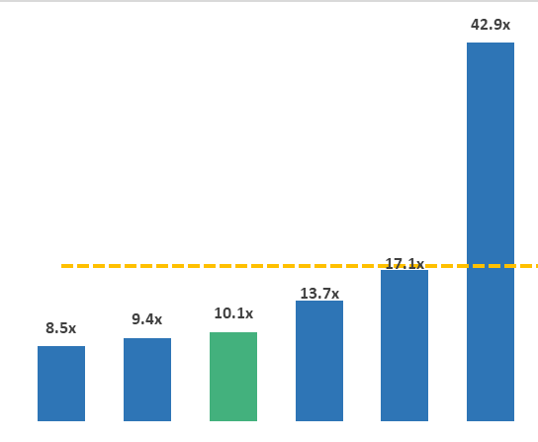
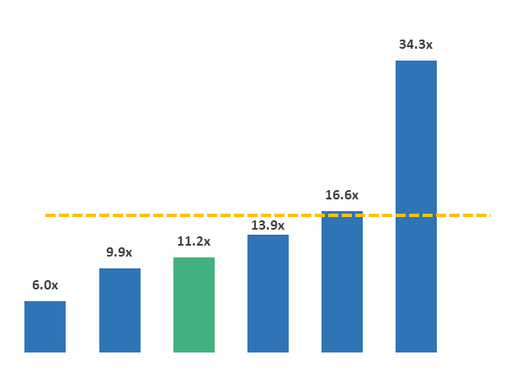
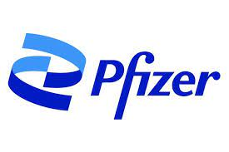
Comps and DCF Models (Financial Models)
Comparable Companies Analysis ($MM)
EV/EBITDA
Price/Earnings
Mean: 16.1x
Mean: 12.2x
Source: Capital IQ
All data are LTM
Notes:
Bayron

Slide 21
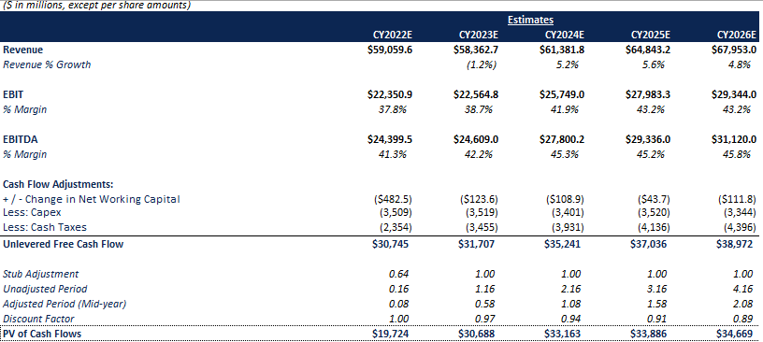
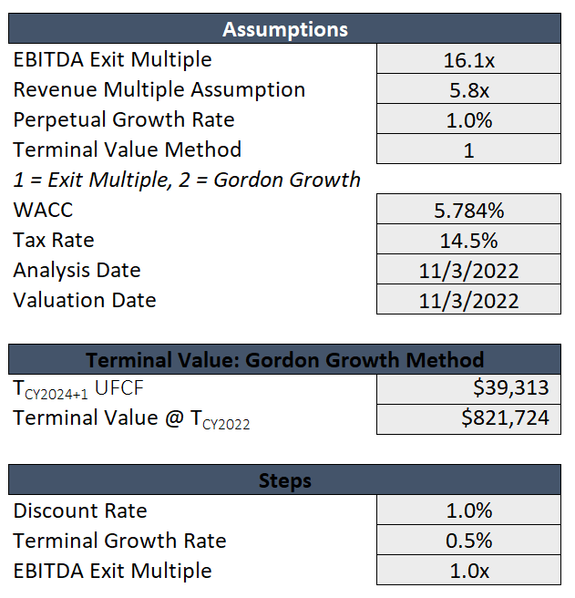
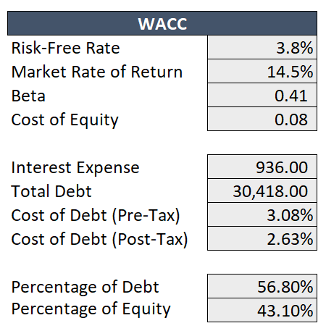
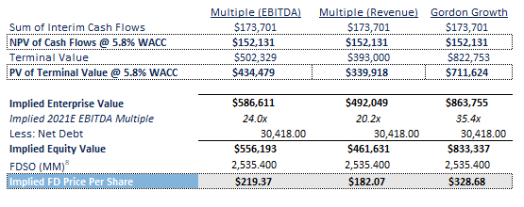
Comps and DCF Models (Financial Models)
Discounted Cash Flow ($MM)
Source: Capital IQ
Notes:
Bayron

Slide 22
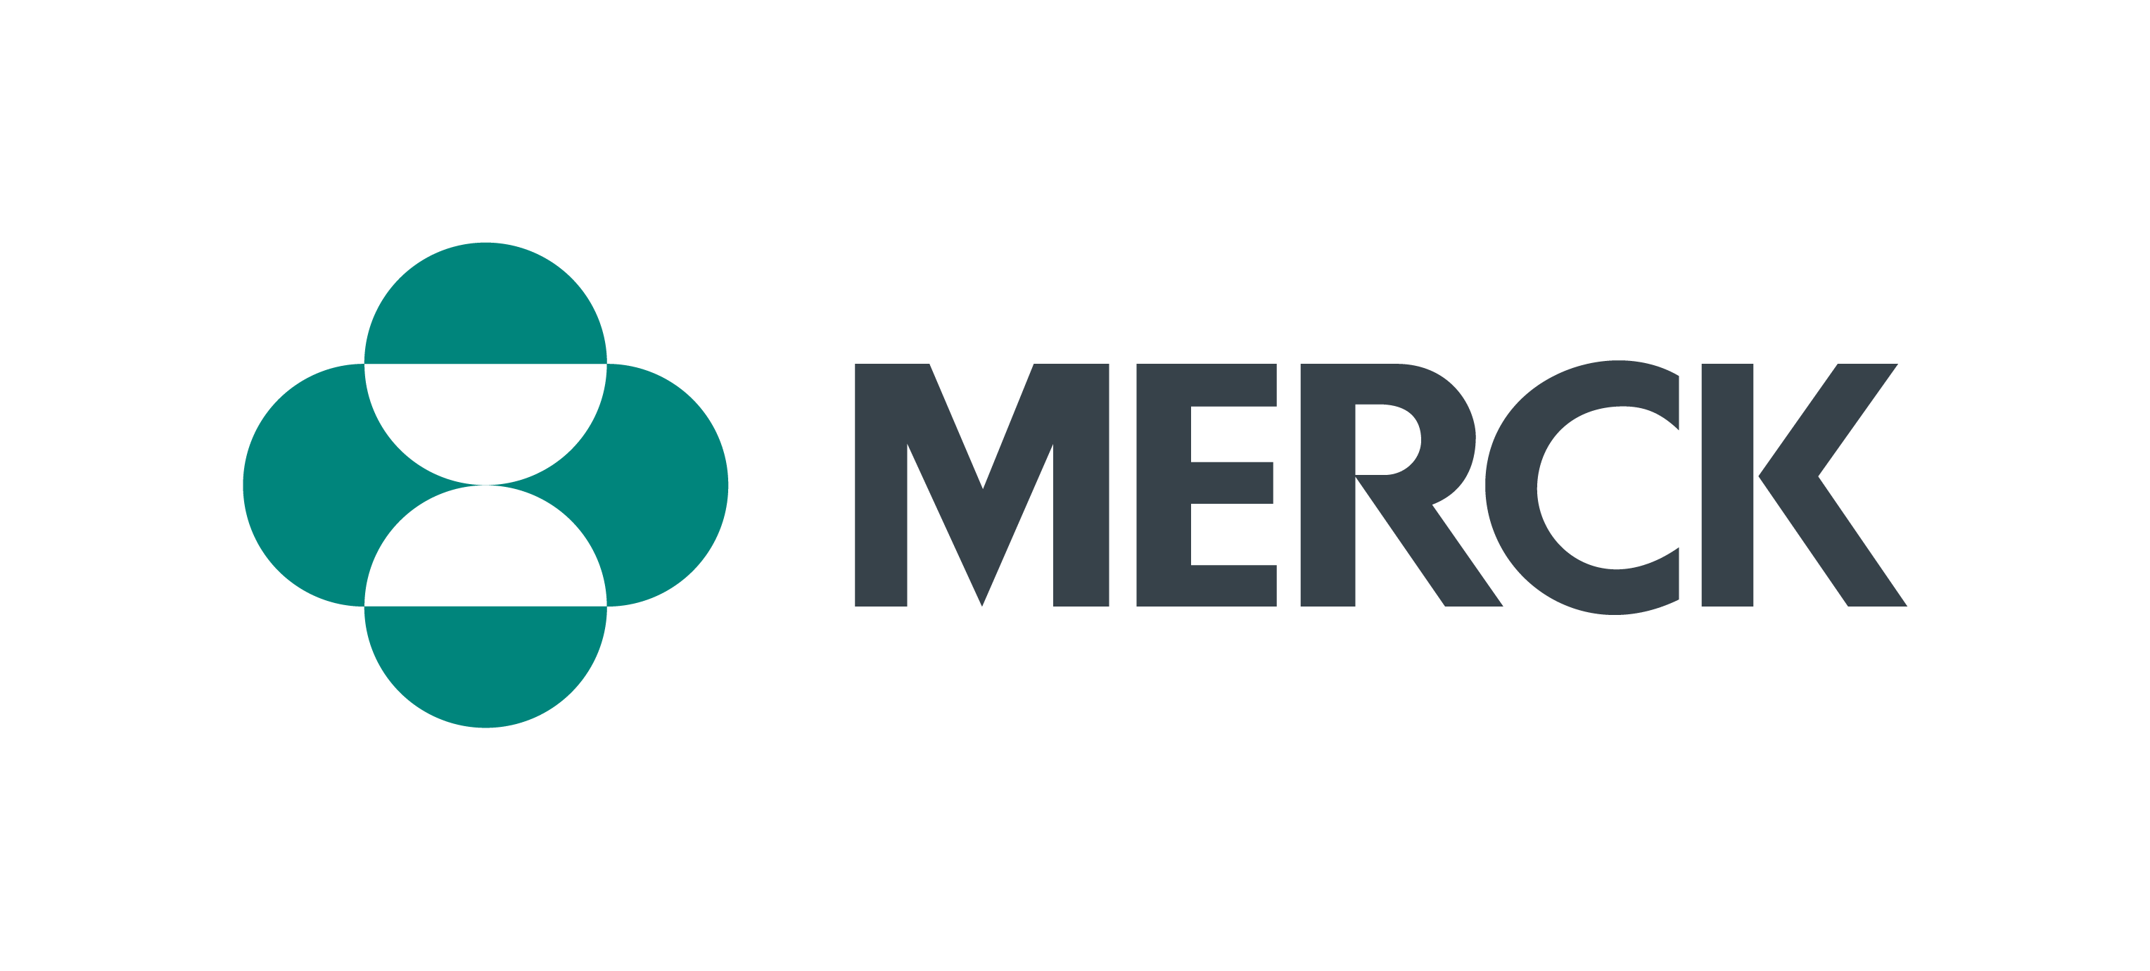
DISCUSSION
DISCUSSION

